Slide 1

WAY TO ENTERPRISE
Spring Framework

Slide 2
Agenda
Global Exception
Basic Authentication
Assignments
Copyright © VTI Academy All Rights Reserved

Slide 3
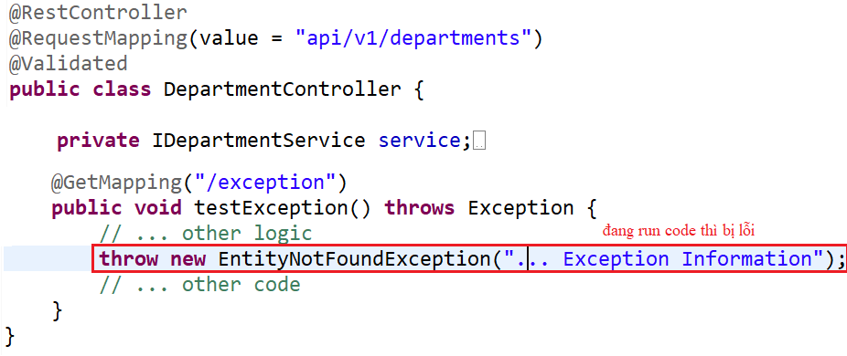
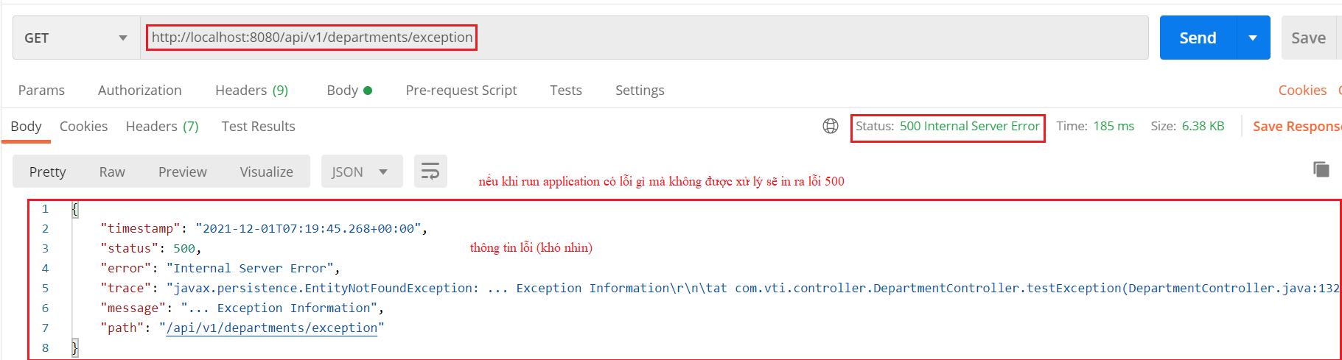
Global Exception
Example 1:
  Local Exception
Error

Slide 4
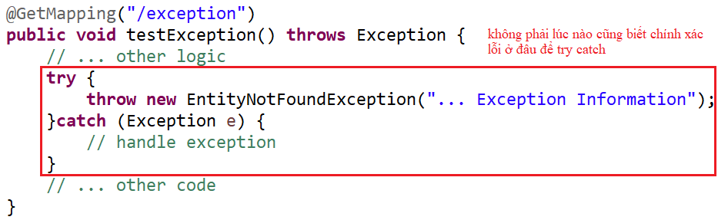
Global Exception
Handling Error

Slide 5
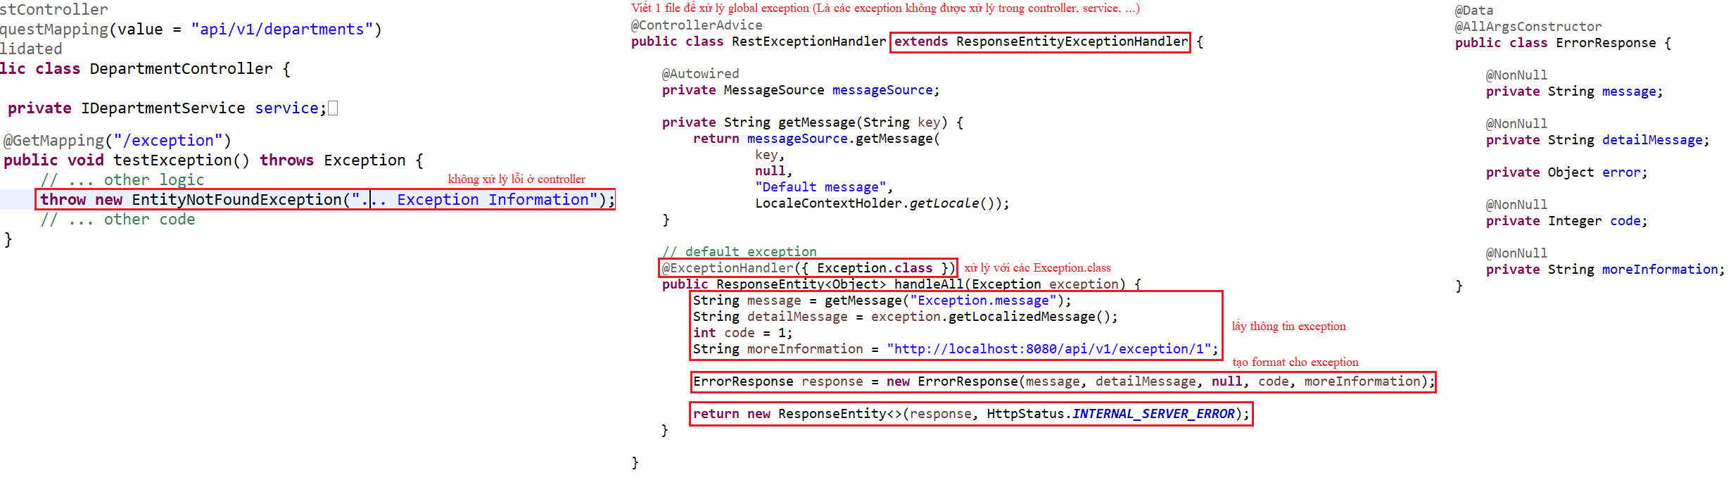
Global Exception
  Global Exception

Slide 6
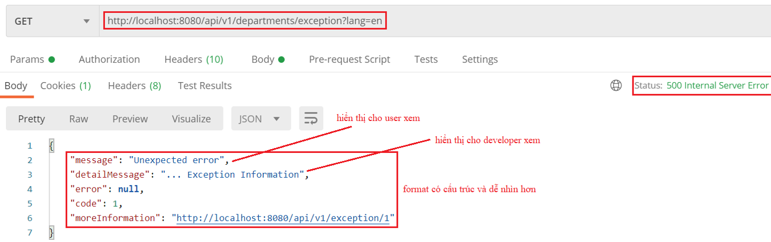
Global Exception

Slide 7
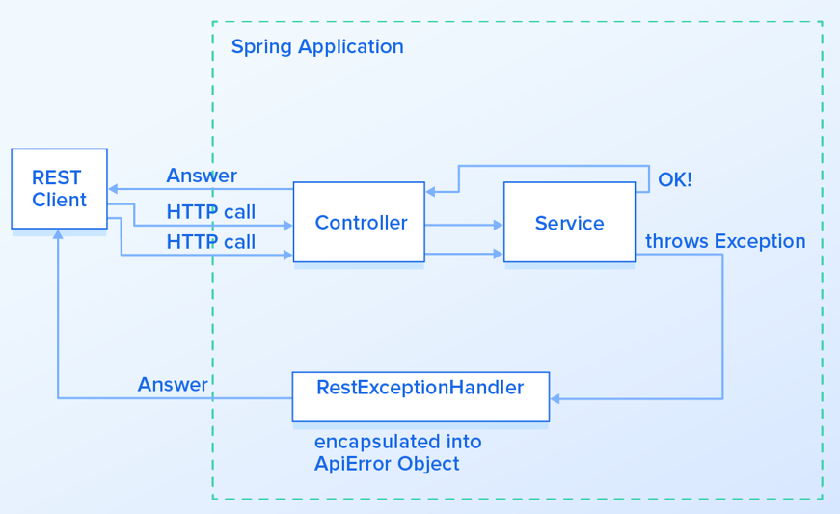
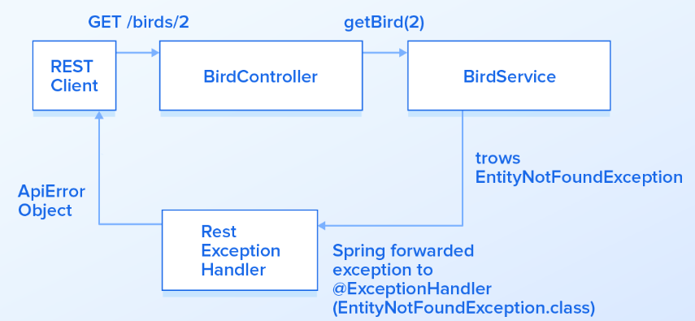
Global Exception

Slide 8
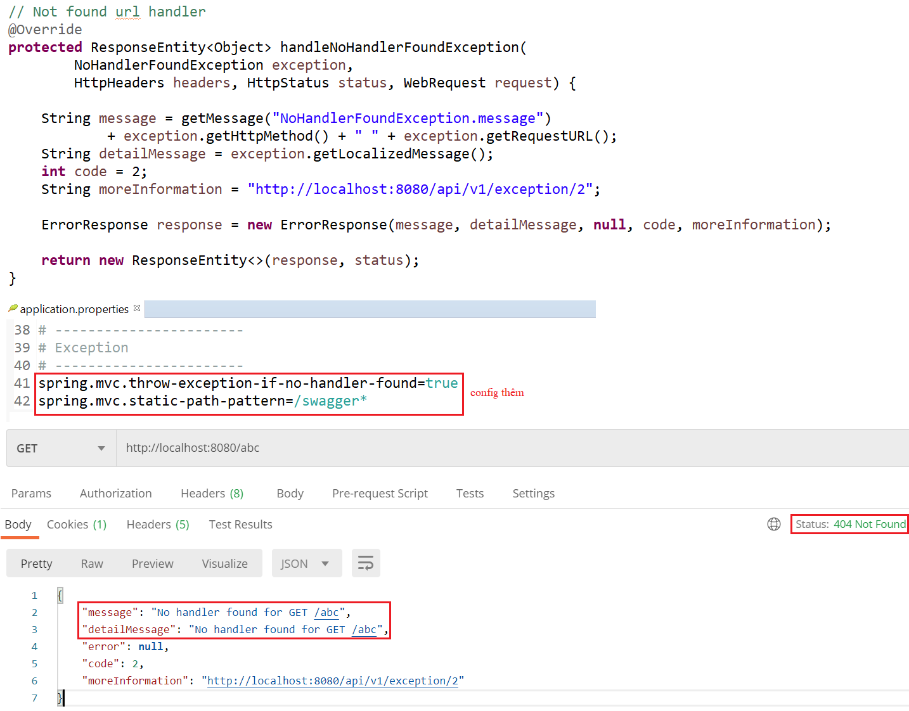
Global Exception
Example 2: Template
NoHandlerFoundException

Slide 9
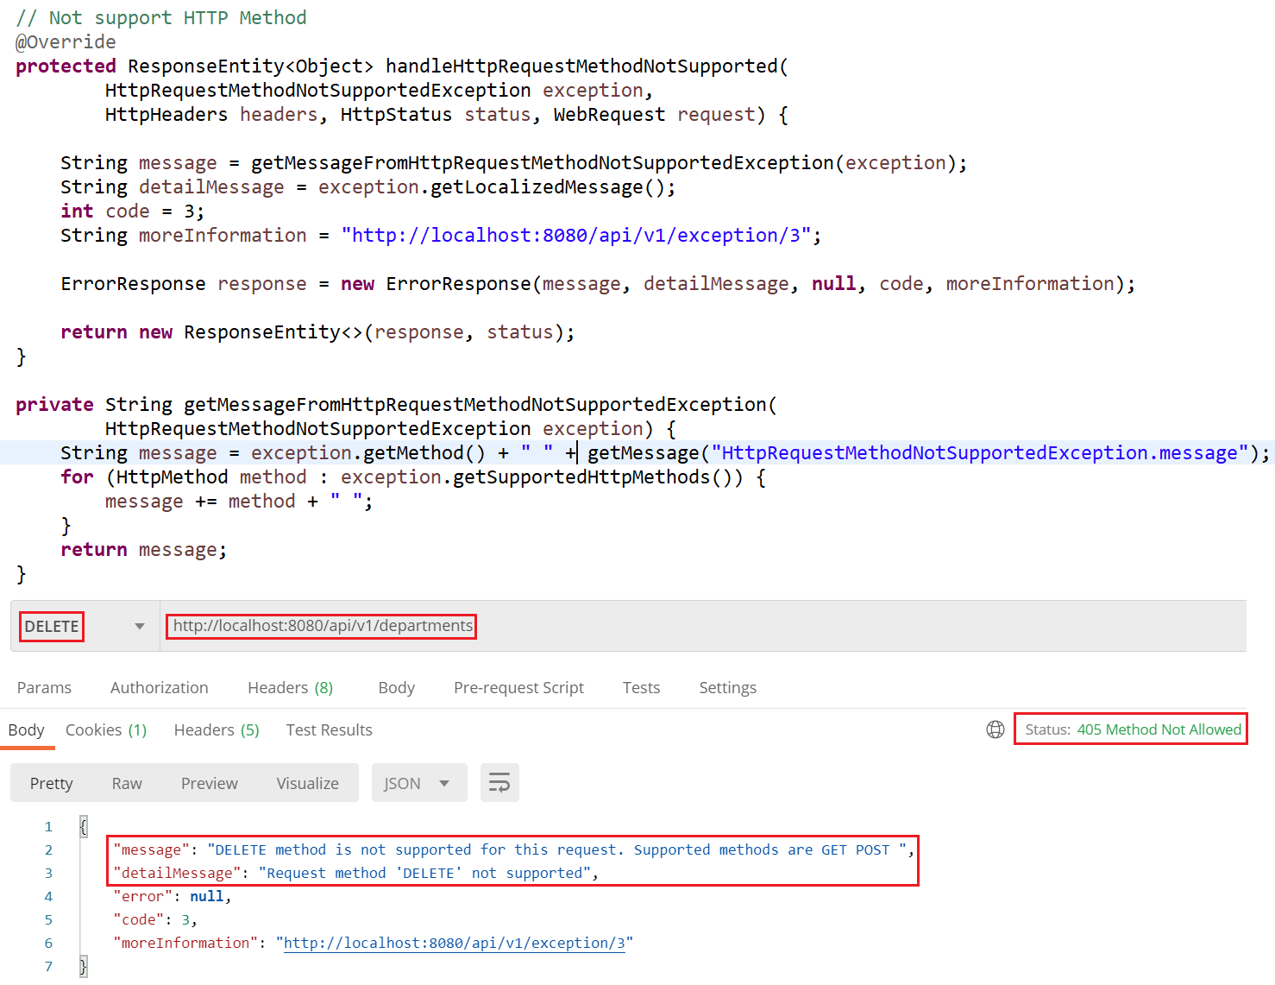
Global Exception
HttpRequestMethodNotSupported

Slide 10
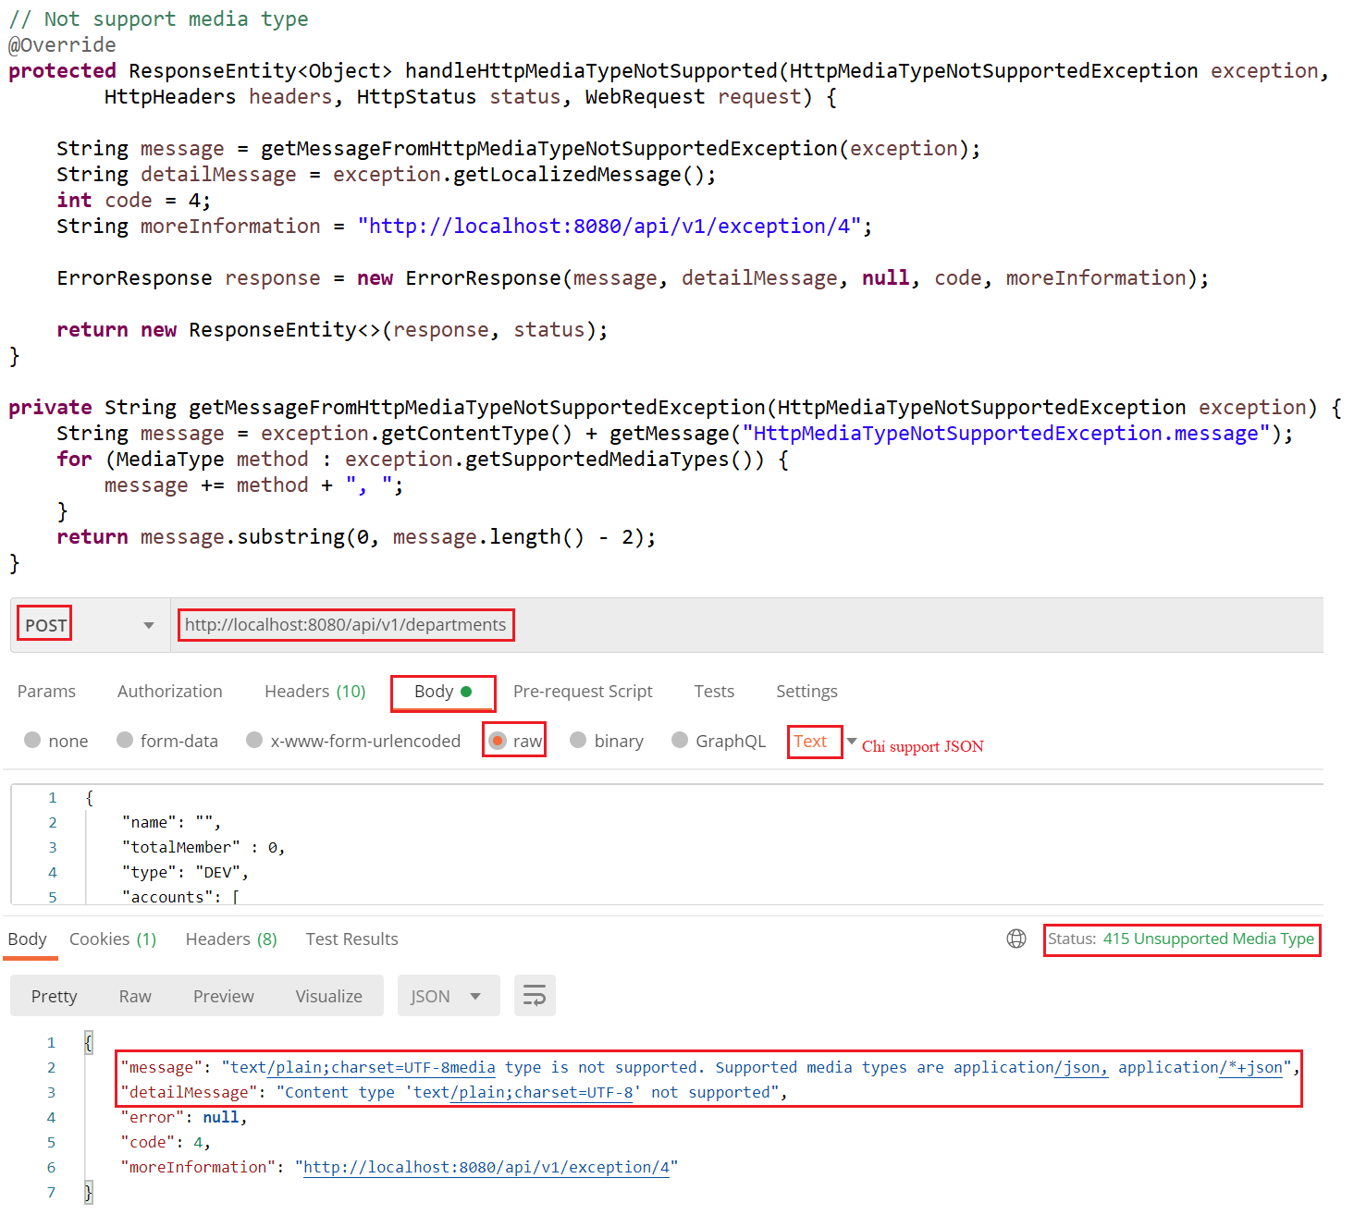
Global Exception
HttpMediaTypeNotSupported

Slide 11
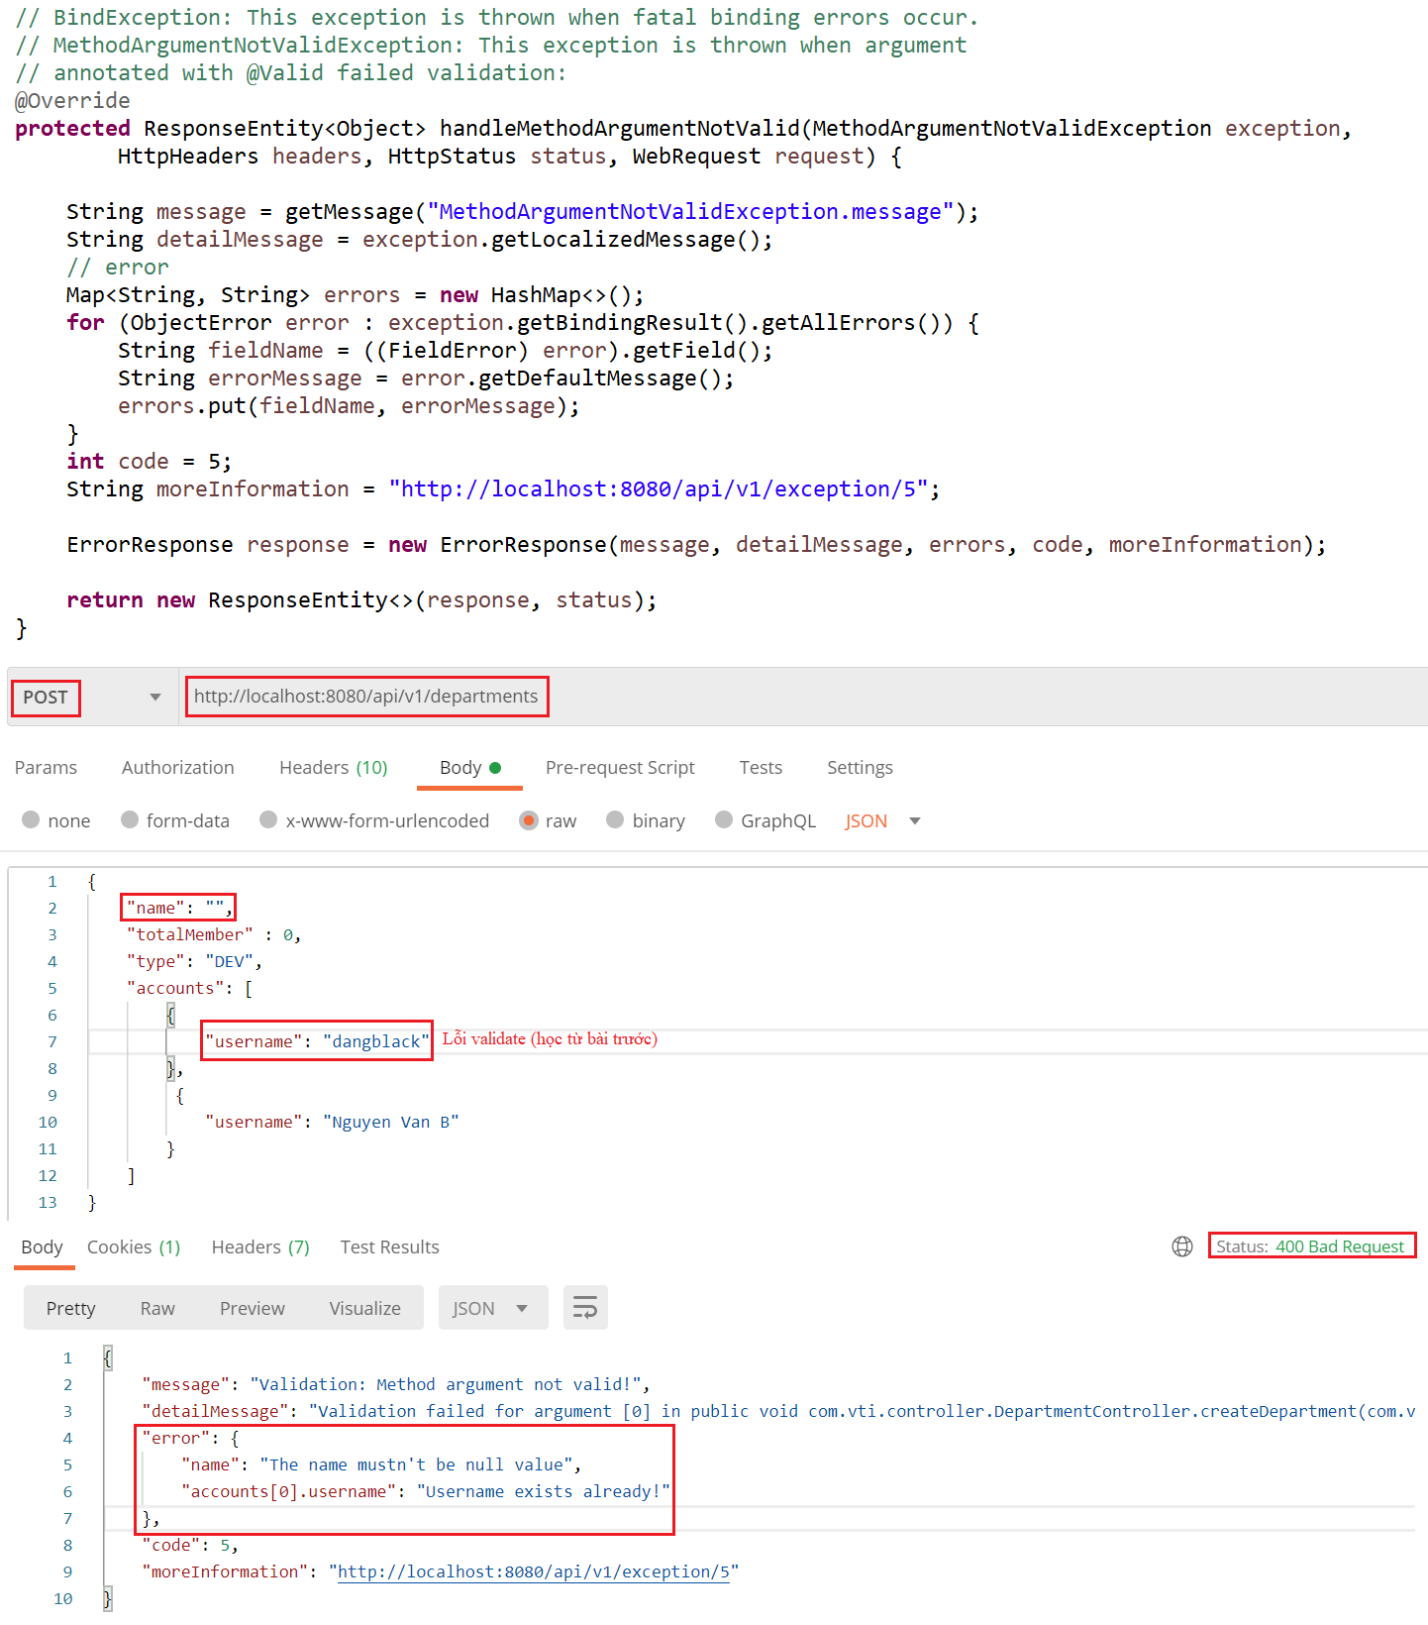
Global Exception
MethodArgumentNotValid

Slide 12
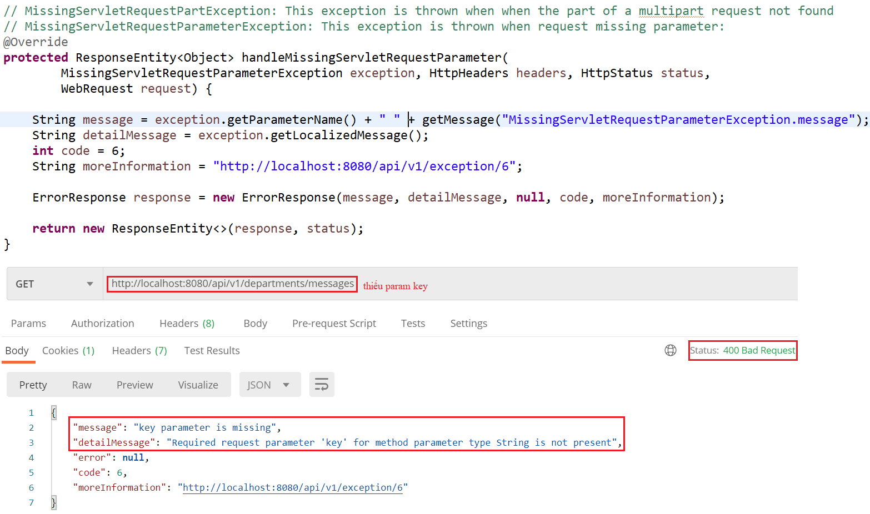
Global Exception
MissingServletRequestParameter

Slide 13
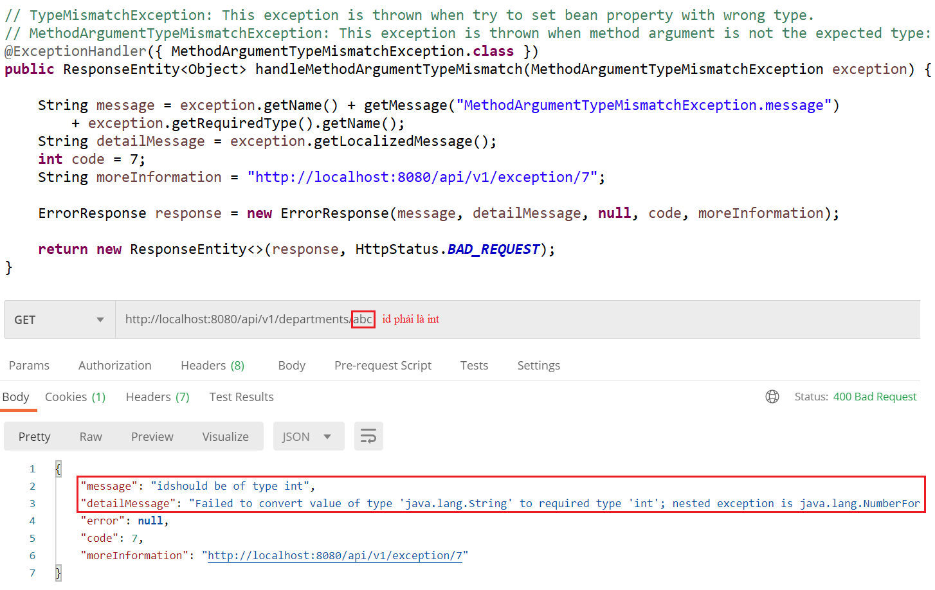
Global Exception
MethodArgumentTypeMismatch

Slide 14
Spring Security
Authentication & Authorization
Authentication
  Basic Authentication (Current Lesson)
  JWT (Next Lesson)
  Oauth 2 (Next Lesson)
  ...

Slide 15
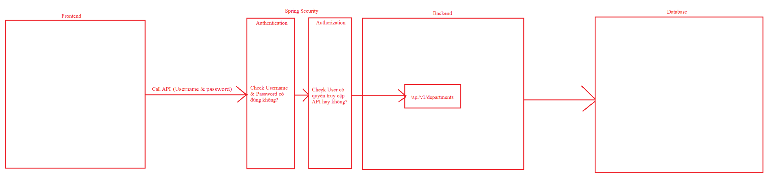
Spring Security

Slide 16
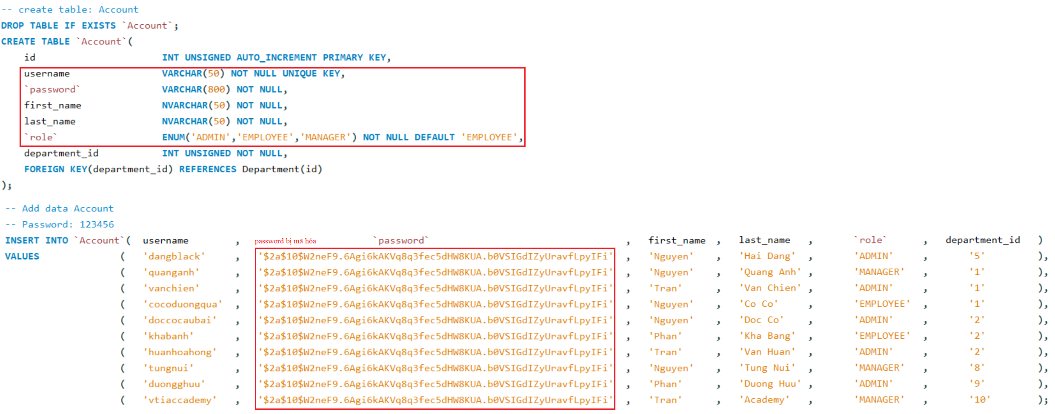
Basic Authentication
Example 1: Authentication
Database

Slide 17
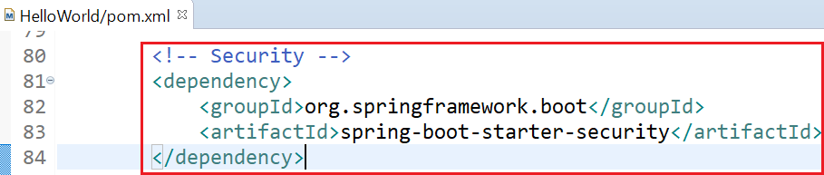
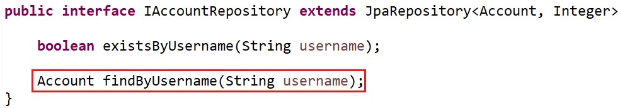
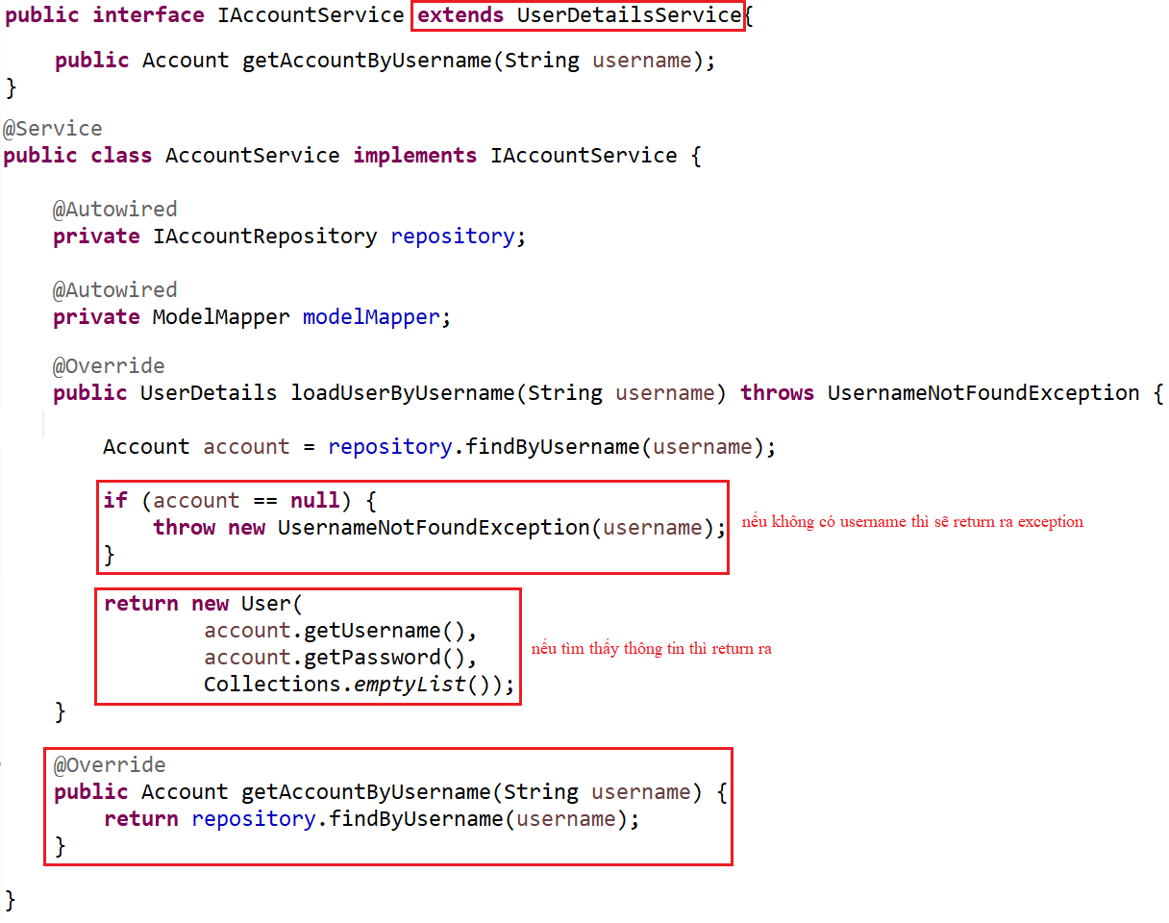
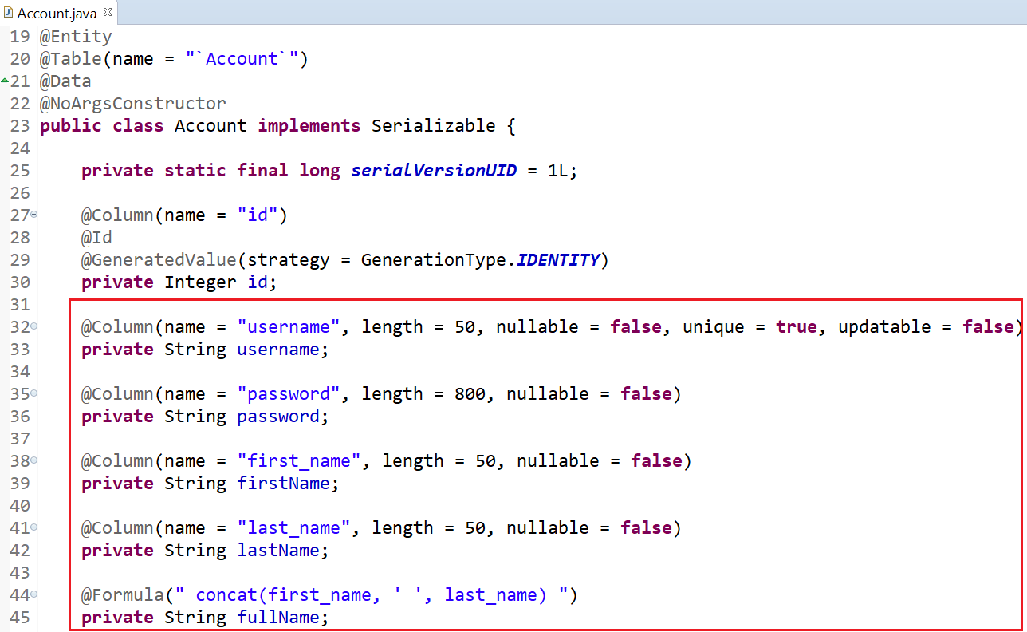
Basic Authentication
pom.xml
Repository
Entity
Service

Slide 18
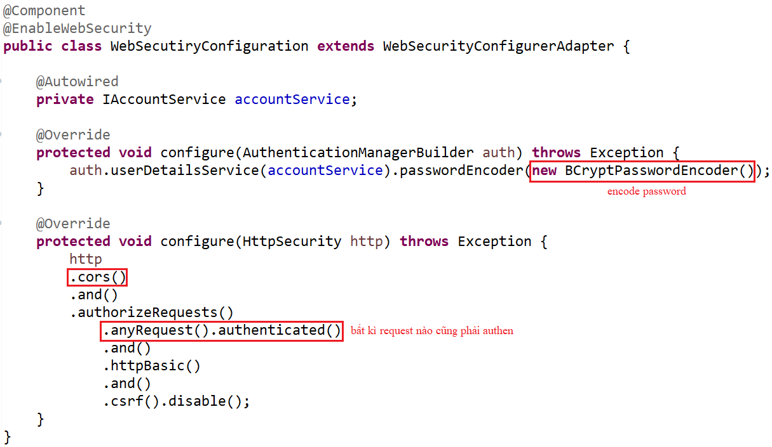
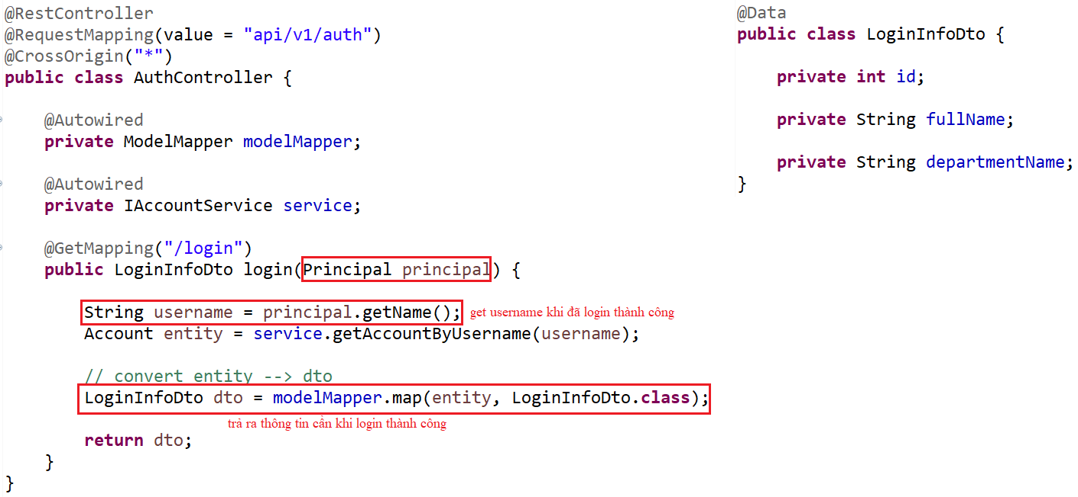
Basic Authentication
Controller
Security Config File

Slide 19
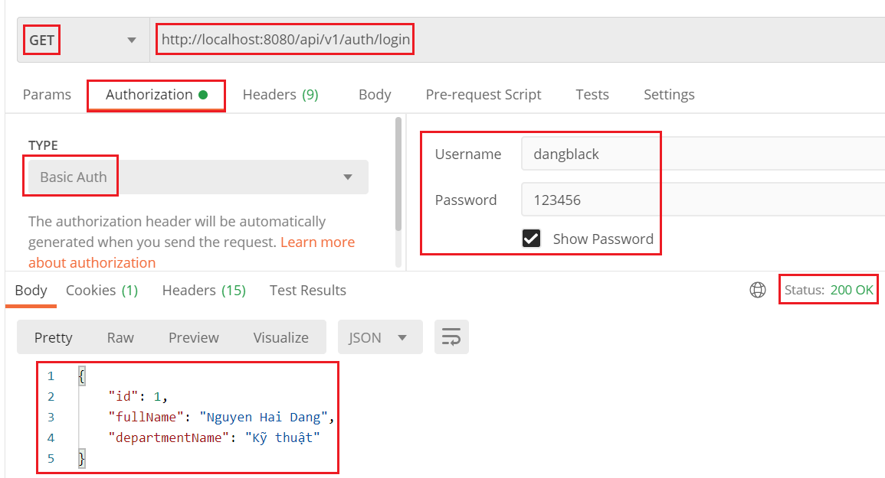
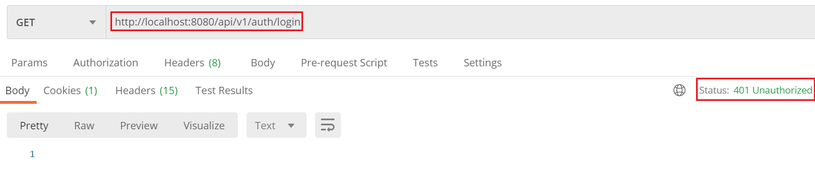
Basic Authentication

Slide 20
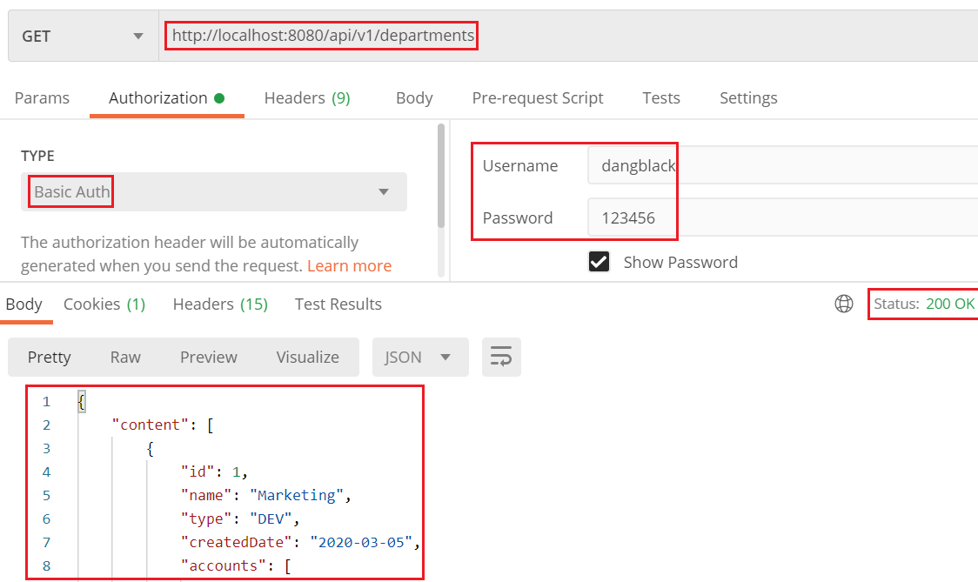
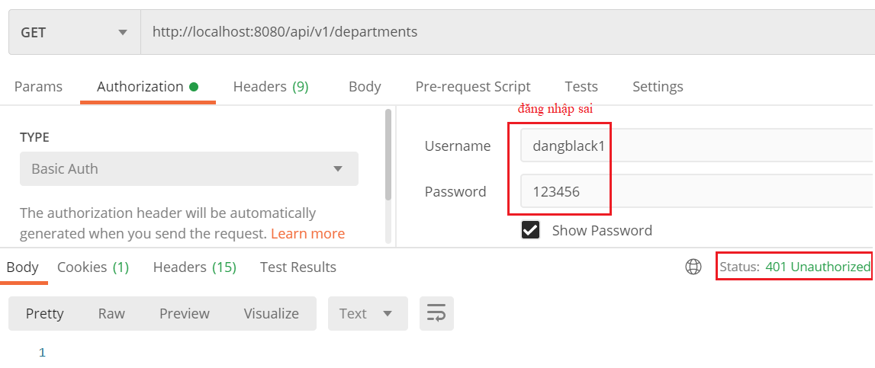
Basic Authentication

Slide 21
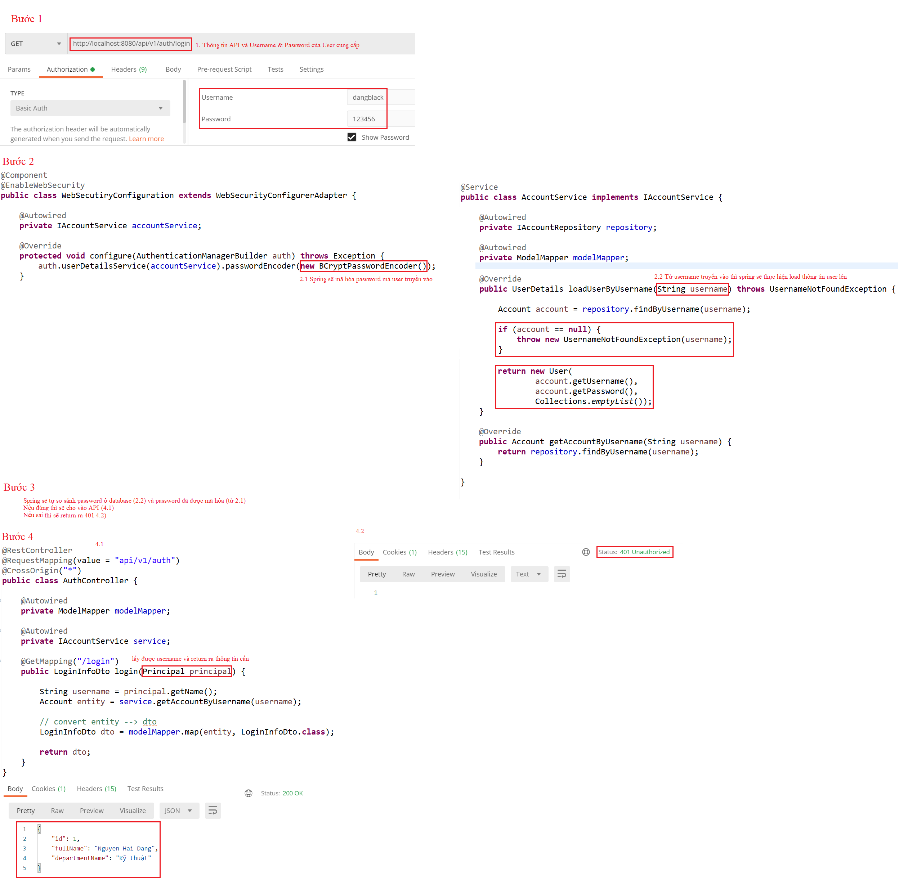
Basic Authentication
  Explain:

Slide 22
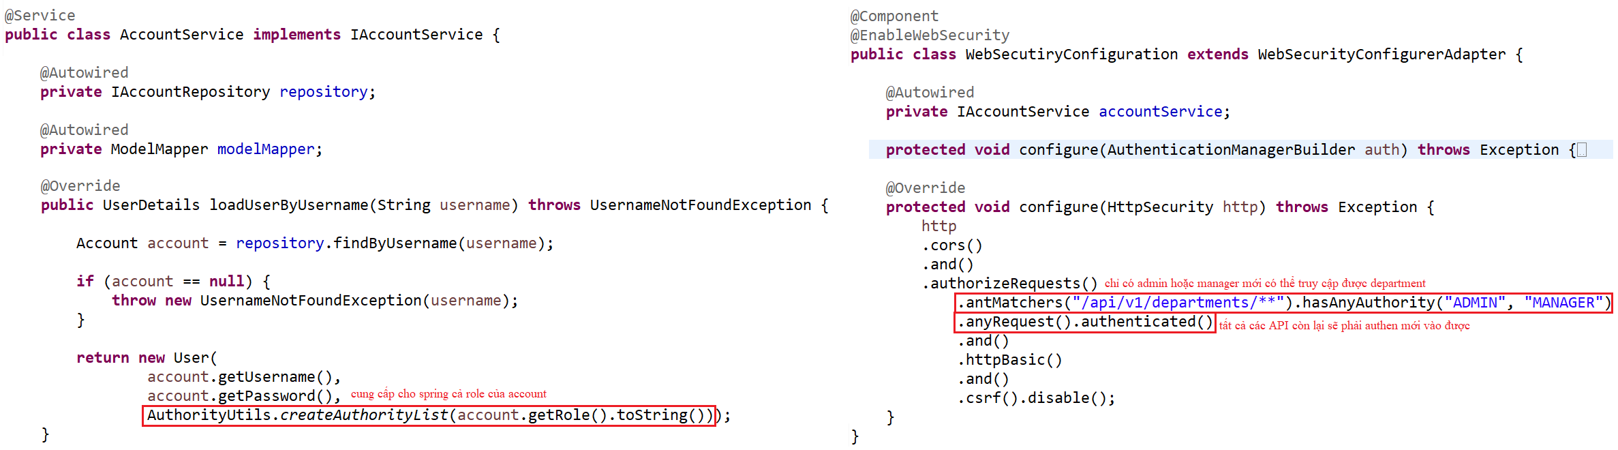
Basic Authentication
Example 2: Authorization
Service
Configuration

Slide 23
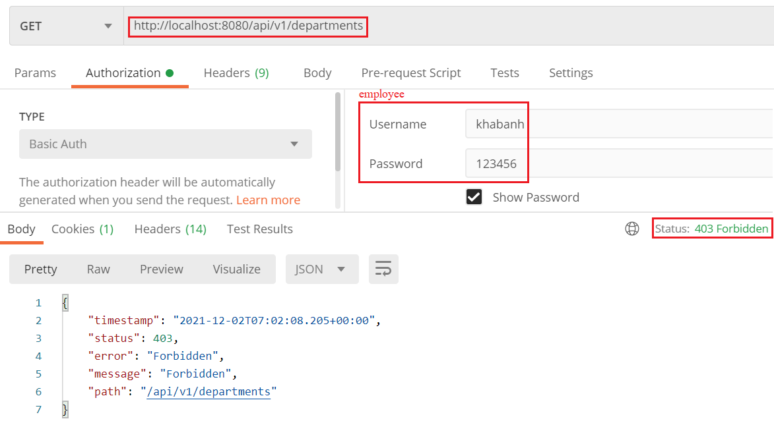
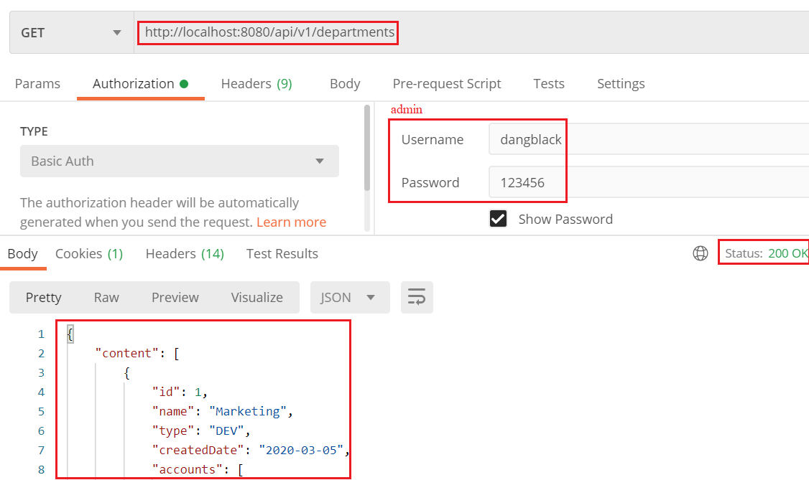
Basic Authentication
Test

Slide 24
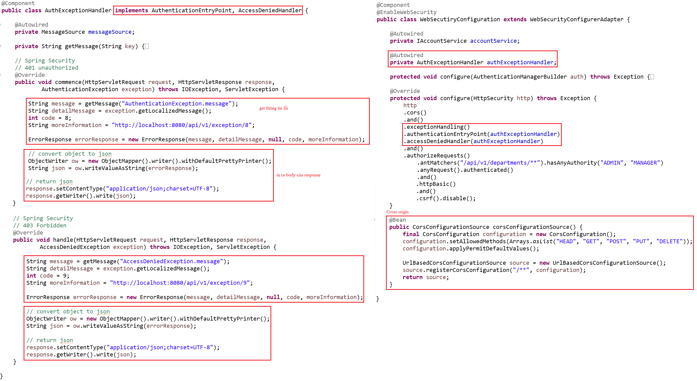
Basic Authentication
Example 3: Cross Origin & Exception

Slide 25
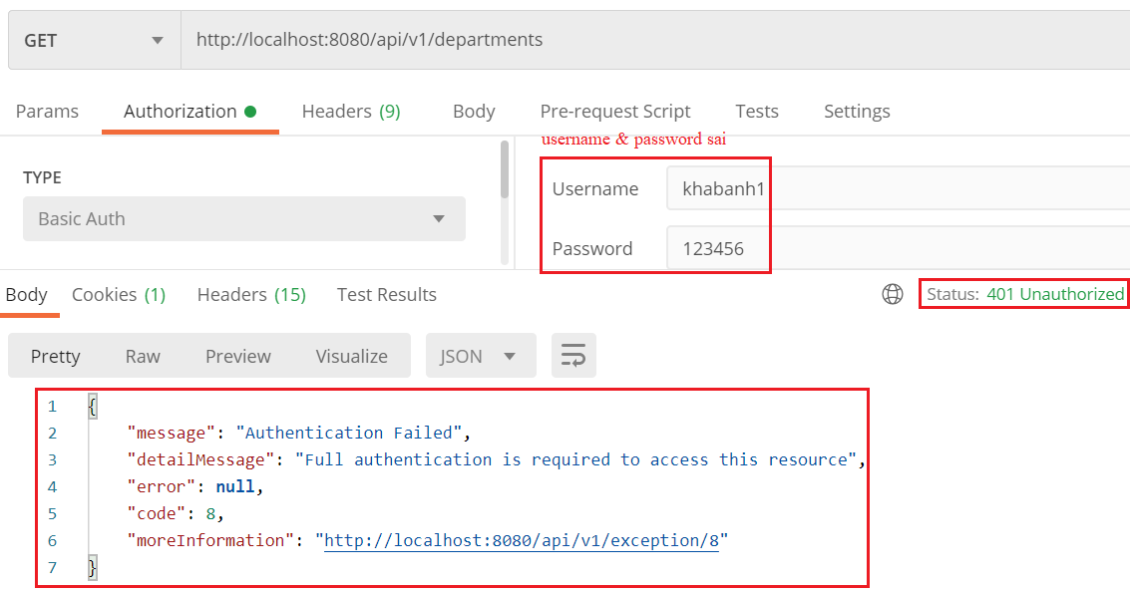
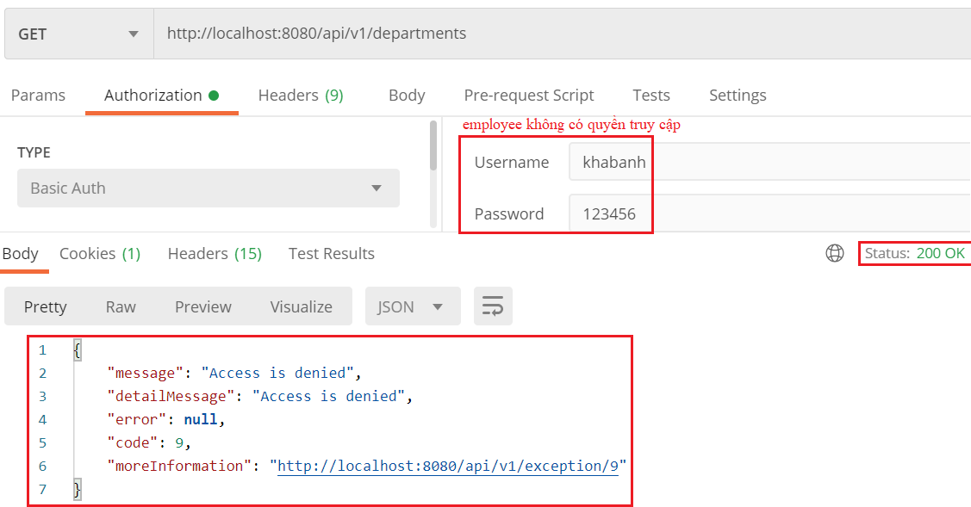
Basic Authentication
Test

Slide 26
Q & A
Copyright © VTI Academy All Rights Reserved

